Slide 1
Sorting Algorithms Lecture 6

Slide 2
Sorting
Arranging elements of set into order.
Let A be a list of n elements A1, A2, ....... An in memory. Sorting of list A refers to the operation of rearranging the contents of A so that they are in increasing (or decreasing) order (numerically or lexicographically); A1 < A2 < A3 < ...... < An.
Examples of Sorting:
Words in a dictionary are sorted (and case distinctions are ignored).
Files in a directory are often listed in sorted order.
The index of a book is sorted (and case distinctions are ignored).

Slide 3
Types of Sorting Algorithms
There are many, many different types of sorting algorithms, but the primary ones are:
Bubble Sort
Selection Sort
Insertion Sort
Merge Sort
Quick Sort
Shell Sort
Radix Sort
Swap Sort
Heap Sort

Slide 4
BUBBLE SORT
In bubble sort:
Each element is compared with its adjacent element.
If the first element is larger than the second one, then the positions of the elements are interchanged, otherwise it is not changed.
Then next element is compared with its adjacent element and the same process is repeated for all the elements in the array until we get a sorted array.

Slide 5
Bubble sort

Slide 6
BUBBLE SORT (STEPS)
Step 1:
Compare A[1] and A[2] and arrange them in the (or desired) ascending order, so that A[1] < A[2].
if A[1] is greater than A[2] then interchange the position of data by swap = A[1]; A[1] = A[2]; A[2] = swap.
Then compare A[2] and A[3] and arrange them so that A[2] < A[3]. Continue the process until we compare A[N – 1] with A[N].

Slide 7
BUBBLE SORT (STEPS)
Step 2:
Repeat step 1 with one less comparisons that is, now stop comparison at A [n – 1] and possibly rearrange A[N – 2] and A[N – 1] and so on.
Step n – 1:
Compare A[1]with A[2] and arrange them so that A[1] < A[2].

Slide 8
BUBBLE SORT EXAMPLE
First Pass:
( 5 1 4 2 8 ) ( 1 5 4 2 8 ), Here, algorithm compares the first two elements, and swaps since 5 > 1.
( 1 5 4 2 8 ) ( 1 4 5 2 8 ), Swap since 5 > 4
( 1 4 5 2 8 ) ( 1 4 2 5 8 ), Swap since 5 > 2
( 1 4 2 5 8 ) ( 1 4 2 5 8 ), Now, since these elements are already in order (8 > 5), algorithm does not swap them.

Slide 9
BUBBLE SORT EXAMPLE
Second Pass:
( 1 4 2 5 8 ) ( 1 4 2 5 8 )
( 1 4 2 5 8 ) ( 1 2 4 5 8 ), Swap since 4 > 2
( 1 2 4 5 8 ) ( 1 2 4 5 8 )
( 1 2 4 5 8 ) ( 1 2 4 5 8 )
Now, the array is already sorted, but our algorithm does not know if it is completed. The algorithm needs one whole pass without any swap to know it is sorted.

Slide 10
BUBBLE SORT EXAMPLE
Third Pass:
( 1 2 4 5 8 ) ( 1 2 4 5 8 )
( 1 2 4 5 8 ) ( 1 2 4 5 8 )
( 1 2 4 5 8 ) ( 1 2 4 5 8 )
( 1 2 4 5 8 ) ( 1 2 4 5 8 )

Slide 11
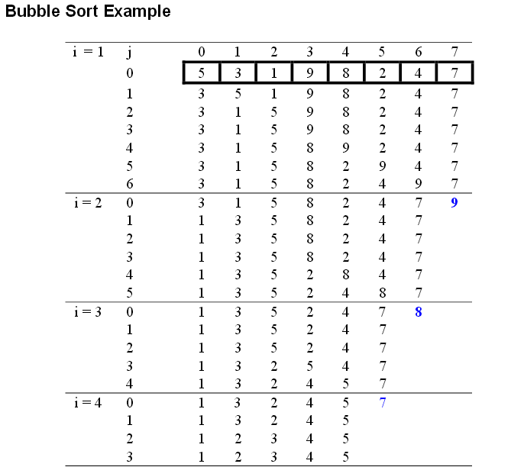
BUBBLE SORT EXAMPLE 2

Slide 12
BUBBLE SORT EXAMPLE 2

Slide 13
BUBBLE SORT EXAMPLE 2

Slide 14
BUBBLE SORT EXAMPLE 2

Slide 15
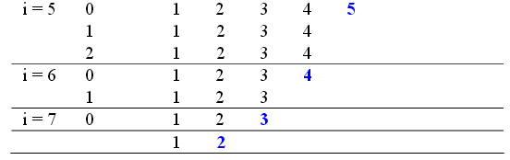
BUBBLE SORT EXAMPLE 2

Slide 16
ALGORITHM
Let A be a linear array of n numbers. Swap is a temporary variable for swapping (or interchange) the position of the numbers.
1. Input n numbers of an array A
2. Initialize i = 0 and repeat through step 4 if (i < n)
3. Initialize j = 0 and repeat through step 4 if (j < n – i – 1)
4. If (A[j] > A[j + 1])
(a) Swap = A[j]
(b) A[j] = A[j + 1]
(c) A[j + 1] = Swap
5. Display the sorted numbers of array A
6. Exit.

Slide 17
Bubble Sort Code
void bubbleSort (int a[ ] , int size)
{
int i, j, temp;
for ( i = 0; i < size; i++ ) /* controls passes through the list */
{
for ( j = 0; j < size - i-1; j++ ) /* performs adjacent comparisons */
{
if ( a[ j ] > a[ j+1 ] ) /* determines if a swap should occur */
{
temp = a[ j ]; /* swap is performed */
a[ j ] = a[ j + 1 ];
a[ j+1 ] = temp;
}
}
}
}

Slide 18
Bubble Sort – Analysis
Best-case: ➔ O(n)
Array is already sorted in ascending order.
The number of moves: 0 ➔ O(1)
The number of key comparisons: (n-1) ➔ O(n)
Worst-case: ➔ O(n²)
Array is in reverse order:
Outer loop is executed n-1 times,
The number of moves: 3*(1+2+...+n-1) = 3 * n*(n-1)/2 ➔ O(n²)
The number of key comparisons: (1+2+...+n-1)= n*(n-1)/2 ➔ O(n²)
Average-case: ➔ O(n²)
We have to look at all possible initial data organizations.
So, Bubble Sort is O(n²)

Slide 19
Selection Sort Algorithm (ascending)
Find smallest element (of remaining elements).
Swap smallest element with current element (starting at index 0).
Finished if at the end of the array. Otherwise, repeat 1 and 2 for the next index.

Slide 20
SELECTION SORT
Selection sort :
It finds the smallest element of the array and interchanges it with the element in the first position of the array.
Then it finds the second smallest element from the remaining elements in the array and places it in the second position of the array and so on.

Slide 21
SELECTION SORT

Slide 22
SELECTION SORT(STEPS)
Let A be a linear array of ‘n’ numbers, A [1], A [2], A [3],...... A [n].
Step 1:
Find the smallest element in the array of n numbers A[1], A[2], ...... A[n].
Let LOC is the location of the smallest number in the array.
Then interchange A[LOC] and A[1] by swap = A[LOC]; A[LOC] = A[1]; A[1] = Swap.

Slide 23
SELECTION SORT(STEPS)
Step 2:
Find the second smallest number in the sub list of n – 1 elements A [2] A [3]...... A [n – 1] (first element is already sorted).
Now we concentrate on the rest of the elements in the array.
Again A [LOC] is the smallest element in the remaining array and LOC the corresponding location then interchange A [LOC] and A [2].
Now A [1] and A [2] is sorted, since A [1] less than or equal to A [2].

Slide 24
SELECTION SORT(STEPS)
Step n – 1:
Find the n – 1 smallest number in the sub array of 2 elements (i.e., A(n–1), A (n)).
Consider A [LOC] is the smallest element and LOC is its corresponding position.
Then interchange A [LOC] and A(n – 1).
Now the array A [1], A [2], A [3], A [4],………..A [n] will be a sorted array.

Slide 25
ALGORITHM
Let A be a linear array of n numbers A [1], A [2], A [3], ……… A [k], A [k+1], …….. A [n]. Swap be a temporary variable for swapping (or interchanging) the position of the numbers. Min is the variable to store smallest number and Loc is the location of the smallest element.
1. Input n numbers of an array A
2. Initialize i = 0 and repeat through step5 if (i < n – 1)
(a) min = a[i]
(b) loc = i
3. Initialize j = i + 1 and repeat through step 4 if (j < n – 1)
4. if (a[j] < min)
(a) min = a[j]
(b) loc = j
5. if (loc ! = i)
(a) swap = a[i]
(b) a[i] = a[loc]
(c) a[loc] = swap
6. display “the sorted numbers of array A”
7. Exit

Slide 26
Selection Sort Example(ascending)
70 75 89 61 37
Smallest is 37
Swap with index 0
37 75 89 61 70
Smallest is 61
Swap with index 1
37 61 89 75 70
Smallest is 70
Swap with index 2
37 61 70 75 89
Smallest is 75
Swap with index 3
Swap with itself
37 61 70 75 89
Don’t need to do last element because there’s only one left
37 61 70 75 89

Slide 27
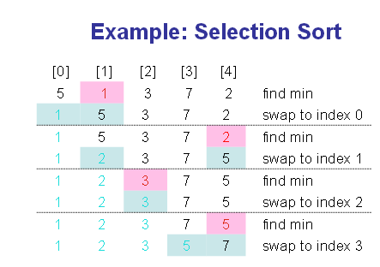
Selection Sort Example 2

Slide 28
Selection Sort Example 2

Slide 29
Selection Sort Example 2

Slide 30
Selection Sort Example 2

Slide 31
Selection Sort Example 2

Slide 32
Selection Sort Example 2

Slide 33
Selection Sort Example 2

Slide 34
Selection Sort Example 2

Slide 35
Selection Sort -- Analysis
In general, we compare keys and move items (or exchange items) in a sorting algorithm (which uses key comparisons).
➔ So, to analyze a sorting algorithm we should count the number of key comparisons and the number of moves.
Ignoring other operations does not affect our final result.
In selection Sort function, the outer for loop executes n-1 times.
We invoke swap function once at each iteration.
➔ Total Swaps: n-1
➔ Total Moves: 3*(n-1) (Each swap has three moves)

Slide 36
Selection Sort – Analysis (cont.)
The inner for loop executes the size of the unsorted part minus 1 (from 1 to n-1), and in each iteration we make one key comparison.
➔ # of key comparisons = 1+2+...+n-1 = n*(n-1)/2
➔ So, Selection sort is O(n²)
The best case, the worst case, and the average case of the selection sort algorithm are same. ➔ all of them are O(n²)
This means that the behavior of the selection sort algorithm does not depend on the initial organization of data.
Since O(n²) grows so rapidly, the selection sort algorithm is appropriate only for small n.
Although the selection sort algorithm requires O(n²) key comparisons, it only requires O(n) moves.
A selection sort could be a good choice if data moves are costly but key comparisons are not costly (short keys, long records).

Slide 37
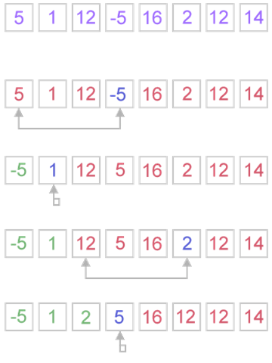
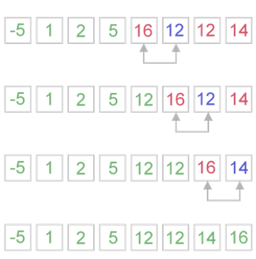
Selection Sort Example 3

Slide 38
Selection Sort Example 3

Slide 39
Selection Sort Example 3

Slide 40
Selection Sort Example 3

Slide 41
Selection Sort Example 3

Slide 42
Selection Sort Example 3

Slide 43
Selection Sort Example 3

Slide 44
Selection Sort Example 3

Slide 45
Selection Sort Example 3

Slide 46
INSERTION SORT
Insertion sort algorithm:
It sorts a set of values by inserting values into an existing sorted file.
Compare the second element with first, if the first element is greater than second, place it before the first one.
Otherwise place is just after the first one.
Compare the third value with second and then with first and so on.

Slide 47
INSERTION SORT

Slide 48
INSERTION SORT (STEPS)
Step 1:
As the single element A [1] by itself is sorted array.
Step 2:
A [2] is inserted either before or after A [1] by comparing it so that A[1], A[2] is sorted array.

Slide 49
INSERTION SORT (STEPS)
Step 3:
A [3] is inserted into the proper place in A [1], A [2], that is A [3] will be compared with A [1] and A [2] and placed before A [1], between A [1] and A[2], or after A [2] so that A [1], A [2], A [3] is a sorted array.
Step n:
A [n] is inserted into its proper place in an array A [1], A [2], A [3], ...... A [n –1] so that A [1], A [2], A [3], ...... ,A [n] is a sorted array.

Slide 50
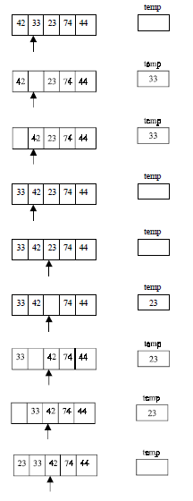
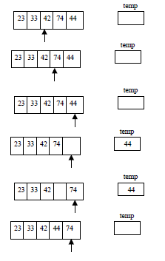
Example

Slide 51
Example

Slide 52
Example

Slide 53
Example

Slide 54
Example

Slide 55
ALGORITHM
Let A be a linear array of n numbers A [1], A [2], A [3], ...... ,A [n]......Swap be a temporary variable to interchange the two values. Pos is the control variable to hold the position of each pass.
1. Input an array A of n numbers
2. Initialize i = 1 and repeat through steps 4 by incrementing i by one.
(a) If (i < = n – 1)
(b) Swap = A [i],
(c) Pos = i – 1
3. Repeat the step 3 if (Swap < A[Pos] and (Pos >= 0))
(a) A [Pos+1] = A [Pos]
(b) Pos = Pos-1
4. A [Pos +1] = Swap
5. Exit

Slide 56
Sources used
Lectures by Mr. Mohammad Asad Abbasi

